Slide 1
Git 101
By:

Slide 2
Git Source
https://git-scm.com/downloads

Slide 3
Version Control
Git is a type of version control
Git is not the only version control tool. There are other tools like:
Manual Saving
DropBox
Google Docs
Wikipedia
SVN

Slide 4
General Commands
To know your git version:
git --version
To change a setting of a file in git:
git config <command>
To change a setting for git overall:
git confing --global

Slide 5
ssh-keygen -t rsa -b 4096 -C "your_email@example.com"
Enter a file in which to save the key (/c/Users/you/.ssh/id_rsa):[Press enter]
Enter passphrase (empty for no passphrase): [Type a passphrase] Enter same passphrase again: [Type passphrase again]
start the ssh-agent in the background eval $(ssh-agent -s)
Add your SSH private key to the ssh-agent
ssh-add ~/.ssh/id_rsa
Add the SSH key to your GitHub account.
$ clip < ~/.ssh/id_rsa.pub
Add the SSH key to your GitHub account.

Slide 6
To go to home directory
Cd ~
To go back
Cd ..
To list files in directory
Ls (horizontal ) 2. Ls -1 ( vertical) 3. Ls -a (all files even hidden files)

Slide 7
Create a directory(Folder)
mkdir dirrectoryName
Create a file:
touch file.txt
Read a file
Cat file.txt
Check your commands history
History

Slide 8
To rename files
mv file1.txt file2.txt

Slide 9
Mini lab
Create a directory
Create a file and write:
Hello GIT
Name:
Email:
Phone:

Slide 10
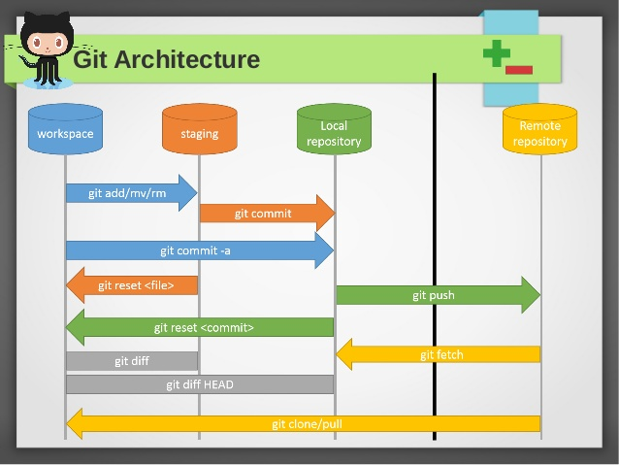
Git

Slide 11
Create repository
git init
To set email and user name
Git config user.email “”
Git config user.name “ ”
Returns files in staging area
git status
Add files from working directory to staging area
git add
Move files from staging area to reprository
git commit -m “Commit msg”

Slide 12
Get a copy of an online repo to access and work on
git clone
Show a detailed differences between working directory and staging area (+ -)
git diff
Find the differences between two commits by entering their ids
git diff id1 id2

Slide 13
Return differences between files in staged area and committed (biwrini en fi 7agat zawdtha aw sheltha been el b3dlo w el commited file)
git diff --staged
To discard and changes either in the working directory or in staging area (will delete the file itself)
Remove file from staging area and discard the changes in it(final)
git reset --hard filename

Slide 14
Notes
Files cannot be committed without being added to staging area
If file is modified you can commit it without adding it to the staging area
Any file that wa committed and then modified is considered in the staging area

Slide 15
Branches
To create new branch
git checkout -b new_branch_name
Switch from branch to branch
git checkout branch_name

Slide 16
Notes
Head= current commit
Github is a service that allows users to interact with git

Slide 17
Push repo in Git Hub
First create a public repo on Git Hub
Returns all remote hubs i created
git remote
To connect to online git
git remote add name”origin” link
To make sure u have connected to Git Hub correctly
git remote -v
To push local repo to remote repo
git push (origin) branch_name(master)
Origin:the name i use in this repo to refer to the repo on git hub
Master: branch name i would like to push

Slide 18
Pull
Make a change in online git and pull the repo to update branch master
Git pull origin master

Slide 19
colne
To get a copy from an online repo to your local repo
git clone URL

